Slide 1
EPP2
Tutorial 6

Slide 2
Part1
Communication Protocols

Slide 3
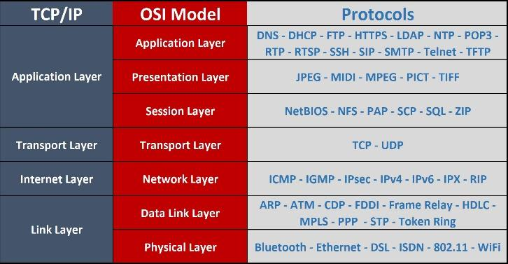
The ISO 7 layer Open Systems Interconnect (OSI) model

Slide 4
The ISO 7 layer Open Systems Interconnect (OSI) model
Physical: Defines voltages, encoding, types of wires to use, number of wires, maximum length of wires, etc.
Link: Defines how one hardware device should send data to another hardware device. Point-to-point.
Network: Defines how data should be routed through a network.
Transport: Defines end-to-end transport of data between two hosts

Slide 5
The ISO 7 layer Open Systems Interconnect (OSI) model
Session: Defines how to set up a session between hosts.
Presentation: Defines data transformations to achieve independence from the underyling hardware. E.g. convert all data to big endian when transmitting, then at the receiving end convert back to the endian-ness of the host. Also includes encryption/decryption.
Application: Defines how to organize communications between two sessions. E.g. the use of RESTful APIs to implement cloud applications, http, etc.

Slide 6
Why is the OSI model needed?
The OSI model allows us to abstract away lower layers and focus only on the layer we are interested in. E.g. when developing an application, we only care about how the application client and server are going to exchange information (e.g. through RESTful API, MQTT, etc).
We don’t need to care about how the lower layers work. Likewise in TCP/IP, the IP layer is only concerned about how to route a packet through a network.
It just assumes that the link and physical layers work. This greatly simplifies designing complex systems.

Slide 7
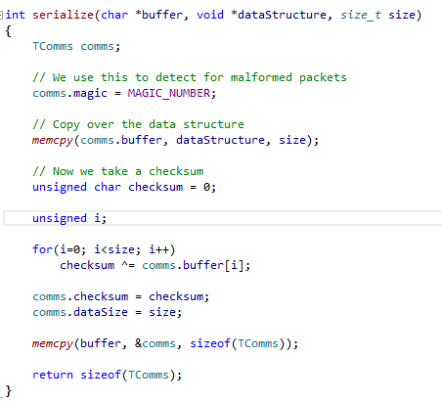
Exploring Serialize.cpp

Slide 8
Exploring Serialize.cpp
The data structure has all its fields arranged in memory. E.g.:
struct {int32_t x, char y} would look like this:
x | x | x | x | y
The serialize function gets a pointer to the start of the structure in the dataStructure argument.

Slide 9
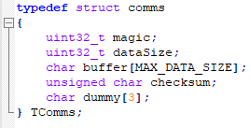
Exploring Serialize.cpp
It creates a new variable comms of type TComms, which contains
  a magic number
  the size of the data to transmit
  a buffer to store the data
  a checksum
  a 3 byte dummy to pad out the checksum to a 4-byte number
  (to prevent alignment issues between the Pi and the Arduino – see previous studio).

Slide 10
Exploring Serialize.cpp
It sets the TComms magic number field to 0xFCFDFEFF.
It copies the entire data structure pointed to by dataStructure into the buffer field of TComms.

Slide 11
Exploring Serialize.cpp
It computes the checksum and puts it into the checksum field of TComms.
It also places the size of the data structure into the size field.

Slide 12
Exploring Serialize.cpp
It then takes the starting address of the comms variable (of type TComms), then uses memcpy to copy it into the buffer, before returning the size of TComms.
In this way it packs the data structure pointed to by dataStructure, together with its checksum, then converts it into a stream of bytes using memcpy.

Slide 13
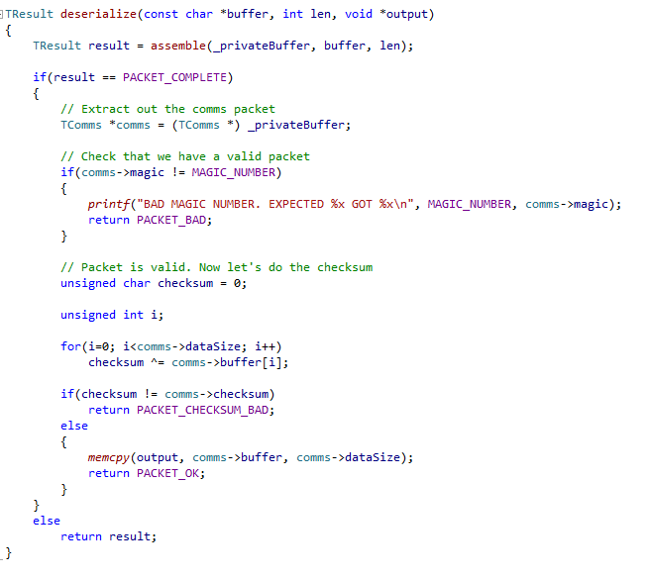
Explore Deserializing

Slide 14
Explore Deserializing
Takes the data received from the USART and calls “assemble” to re-assemble all the bytes into a packet of type TComms.
It checks that the magic number is valid.

Slide 15
Explore Deserializing
It computes the checksum on the buffer field in TComms.
It compares the computed checksum against the checksum field in TComms.
If it matches, it copies the bytes in the buffer (which contains the data for the payload data structure) into the memory pointed to by the output argument. This argument should point to a data structure variable of the appropriate type, to get it deserialized properly.

Slide 16
Data Fragments in USART
One problem with USART is that it sends data in fragments. So if we sent a packet of 64 bytes, the USART might send 32 bytes, then 12 bytes, then 4 bytes, then 16 bytes.
Explain how this might be a problem when trying to transmit a serialized data structure over USART.
We must wait until we get the full 64 bytes before we can sensibly deserialize the data structure; otherwise part of the data structure might be in a later fragment.

Slide 17

Data Fragments in USART
Look at the code in the assemble function, and give a rough explanation how this code solves this problem.
When assemble receives data, it copies the data into a buffer, and counts the number of bytes accumulated so far.

Slide 18
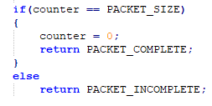
Data Fragments in USART
If the number of bytes accumulated is equal to the expected packet size defined by PACKET_SIZE (actually the size of TComms), it returns a “PACKET_COMPLETE” value to show that the buffer contains a completed packet. It also zeros the byte count.
If not it returns a PACKET_INCOMPLETE value.
If PACKET_INCOMPLETE, then the next time assemble is called with new data, it will continue to add the new data to the previously accumulated data.

Slide 19
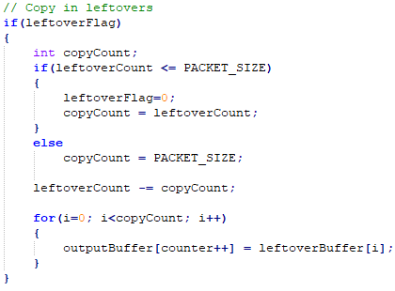
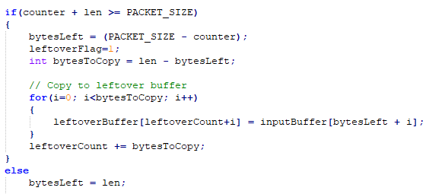
Data Fragments in USART
BONUS PROBLEM: What if you expect 64 bytes, then receive 32 bytes, then 12 bytes, then 4 bytes, then 22 bytes? Now you have 6 bytes extra!!
  We assume that the 6 bytes come from the NEXT packet, and put them aside, setting the leftoverFlag.
  The next time we are called with new data, we first copy over these 6 bytes to the start of the buffer, then proceed as before.

Slide 20
Exploring the Protocol
We will now deep-dive into the protocol that Alex uses to talk to his Arduino, to help you understand protocol design better. Looking at the code in packet.h, Alex-Pi.cpp and Alex.ino, explain:
What the fields in TPacket do.

Slide 21
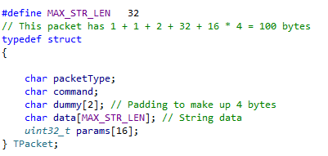
Exploring the Protocol
packetType – Used to mark whether this is a command packet or a status packet.
command – Used in command packets to send go straight, turn left, etc. commands to the Arduino.
dummy – 2 byte padding to make up 4 bytes, together with the 1-byte packetType and command earlier, to avoid alignment issues with the Pi.
params - Parameter values to be sent to the Arduino. The Arduino also uses this to send back telemetry to the Pi in status packets.
data – The data to send to the Arduino.

Slide 22
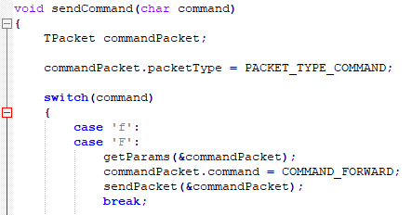
Exploring the Protocol
How sendCommand in Alex-Pi.cpp uses TPacket packet to send a command to move forward 50 cm at 80% power.
Create a new variable commandPacket of type TPacket.
Sets packetType to PACKET_TYPE_COMMAND.
Calls getParams to populate params[0] with distance (50 cm) and params[1] with power (80)
Sets command to COMMAND_FORWARD.

Slide 23
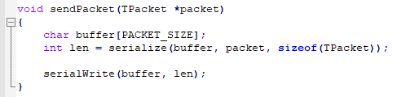
Exploring the Protocol
How this packet is serialized and sent to Alex.
Alex-pi.cpp calls serialize with a pointer to commandPacket.
serialize creates a TComms packet, adds in the magic number, copies over the contents of commandPacket into its data field, computes the checksum, then sends it over the serial link to the Arduino.

Slide 24
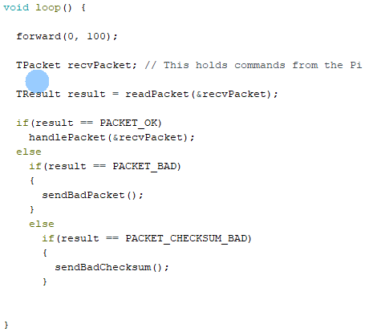
Exploring the Protocol
How, in Alex.ino, the serialized packet is deserialized.
loop() calls readPacket with a pointer to a variable recvPacket of type TPacket.

Slide 25
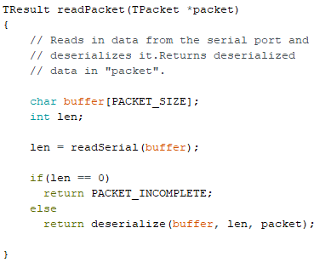
Exploring the Protocol
readPacket calls readSerial to read the packet, and when it gets a complete packet
It then calls deserialize, which will check the magic number and checksum.
If all are valid, will copy over the data in the TComms packet over the packet parameter, which points to the recvPacket variable from loop.

Slide 26
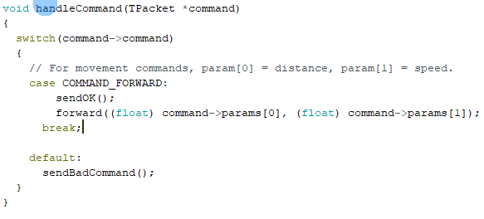
Exploring the Protocol
How the packet is transformed into commands to the motors.
loop() calls handlePacket with recvPacket, which now contains the packet sent by alex-pi.cpp.
handlePacket checks the packetType, and sees it is of type PACKET_TYPE_COMMAND. It passes the packet over to handleCommand
handleCommand sees that the command is COMMAND_FORWARD, and calls the forward function with params[0] (containing 50 meaning 50 cm) and params[1], containing 80, meaning 80% power.
The forward function does analogWrite to the wheel motors, turning them.

Slide 27
Part2
SLAM

Slide 28
SLAM
In studio W9S1, we used SLAM (Hector SLAM) as a black box. The following questions attempt to show you a glimpse of one aspect of a typical SLAM algorithm, namely landmark extraction. The main idea is to process the data points reported by sensor (e.g. LiDAR) to extract landmark(s), e.g. wall, table etc.
[Spike Extraction] The "Landmark.xlsx" excel file contains one complete 360 degree of LiDAR data, similar to those collected from the W8S1 – LiDAR studio. A X-Y scatter plot is also provided for ease of visualization.

Slide 29
Spike Extraction
One simple way to find "interesting" points is to look for abrupt change in the data points. Perform the following in excel:
Calculate the 2D distance with the previous point
Ignore those points with low quality (anything <= 128) as they usually means bad / error data
Find out points with a large enough distance with previous point. This is known as a "spike"
Use the X-Y scatter plot and the identified spike points to discuss their significance. (i.e. how are these spike points useful / interesting?)

Slide 30
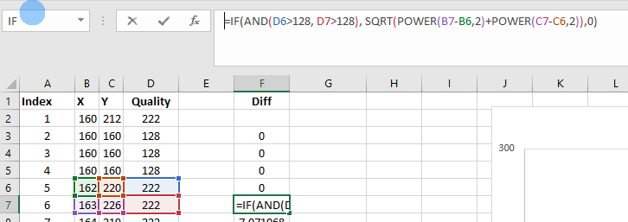
Spike Extraction
The spike points usually indicate the starting / ending point of a landmark. e.g. the edge of a table, the starting point of a wall segment etc. If there are spike points close by, the group of data may indicate a small object in the real world, e.g. a chair, a person, etc.

Slide 31
Is that a Wall?
It is quite cool to see Hector SLAM in action. Instead of the multiple LiDAR points we see in W8S1, solid lines representing real world obstacle are drawn instead. Let's take a look at how such "line segment" can be deduced from data points computationally.
First, take a look at the basic idea of RANSAC (RANdom SAmple Consesus) at wikipedia https://en.wikipedia.org/wiki/Random_sample_consensus . The overview is pretty high level and sufficient for our discussion.

Slide 32
RANSAC applied to LiDAR Data
While
  There are still unassociated LiDAR readings,
  and the number of readings is larger than the consensus,
  and we have done less than N trials.

Slide 33
RANSAC applied to LiDAR Data
Do:
  Select a random laser data reading.
  Randomly sample S data readings within D degrees of this LiDar data reading (for example, choose 5 sample readings that lie within 10 degrees of the randomly selected laser data reading).
  Using these S samples and the original reading calculate a least squares best fit line.
  Determine how many laser data readings lie within X centimeters of this best fit line.

Slide 34
RANSAC applied to LiDAR Data
  If the number of laser data readings on the line is above some consensus C do the following:
  Calculate new least squares best fit line based on all the laser readings determined to lie on the old best fit line.
  Add this best fit line to the lines we have extracted.
  Remove the number of readings lying on the line from the total set of unassociated readings.

Slide 35
Summary
In this tutorial we reviewed in more detail the communication protocol between the RPi and the Arduino.
It can be seen that it is not trivial and you need to factor in potential issues with the transmission (e.g. fragmented packets, data corruption, etc)
The LiDAR uses complex algorithms to decode the data and derive meaning information.
Though we may be satisfied with using API’s to obtain the required results and data, it is good to have some understanding on how things work at the lower-level.

